Slide 1
Taking a Trip Across Canada
What you will see in the provinces

Slide 2


Today I will learn …
Today I will learn the differences between the provinces in Canada.
I will see what they each look like.
I will learn what people do in each province for work (industry)

Slide 3
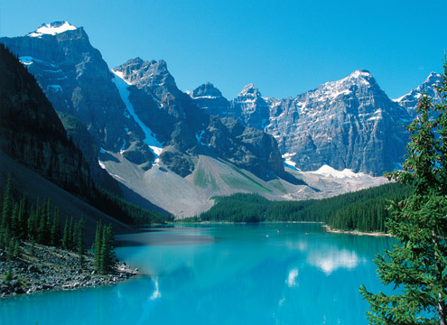
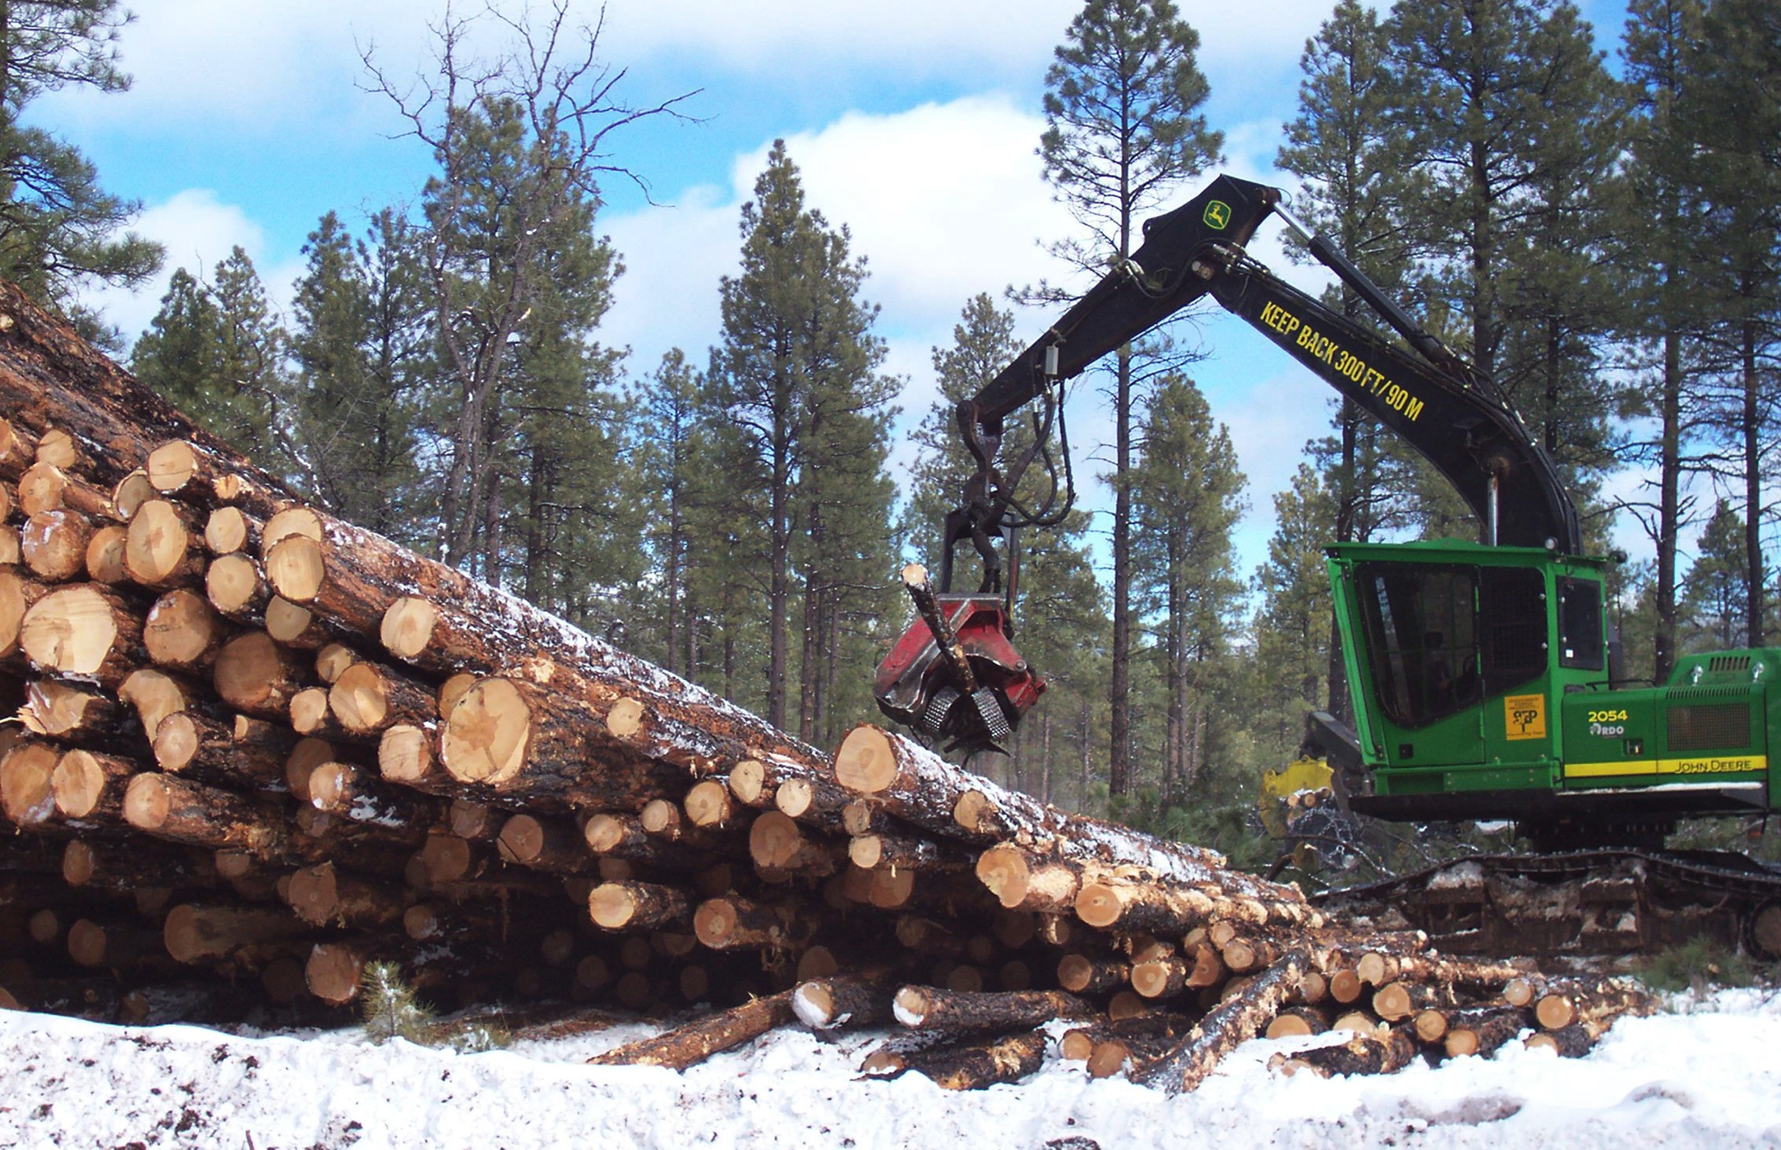
British Columbia
British Columbia is covered in the Rocky Mountains.
Because it is so beautiful, one of the main industries is tourism.
It is also covered in forests, so another main industry is forestry.

Slide 4
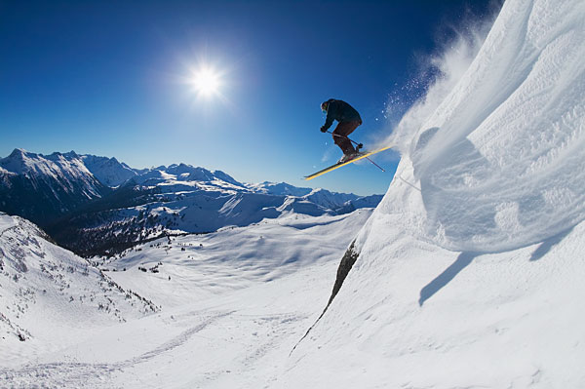
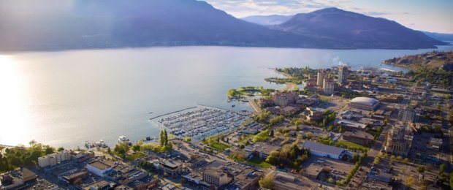
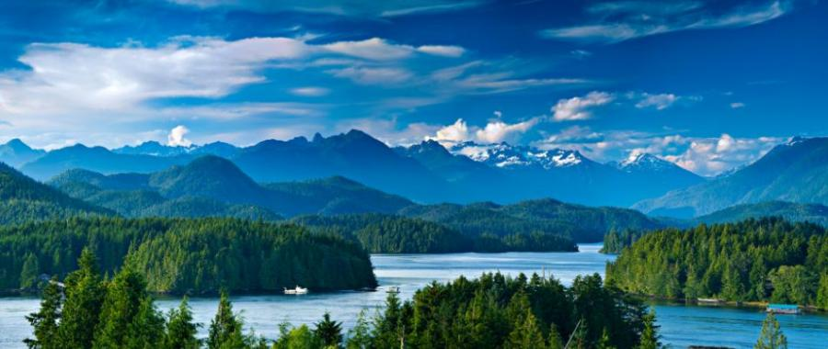
Visit BC
If you were to visit BC, you could go skiing.
You could visit the Okanagan.
You could visit Vancouver Island.

Slide 5
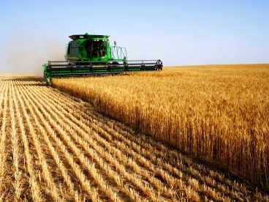
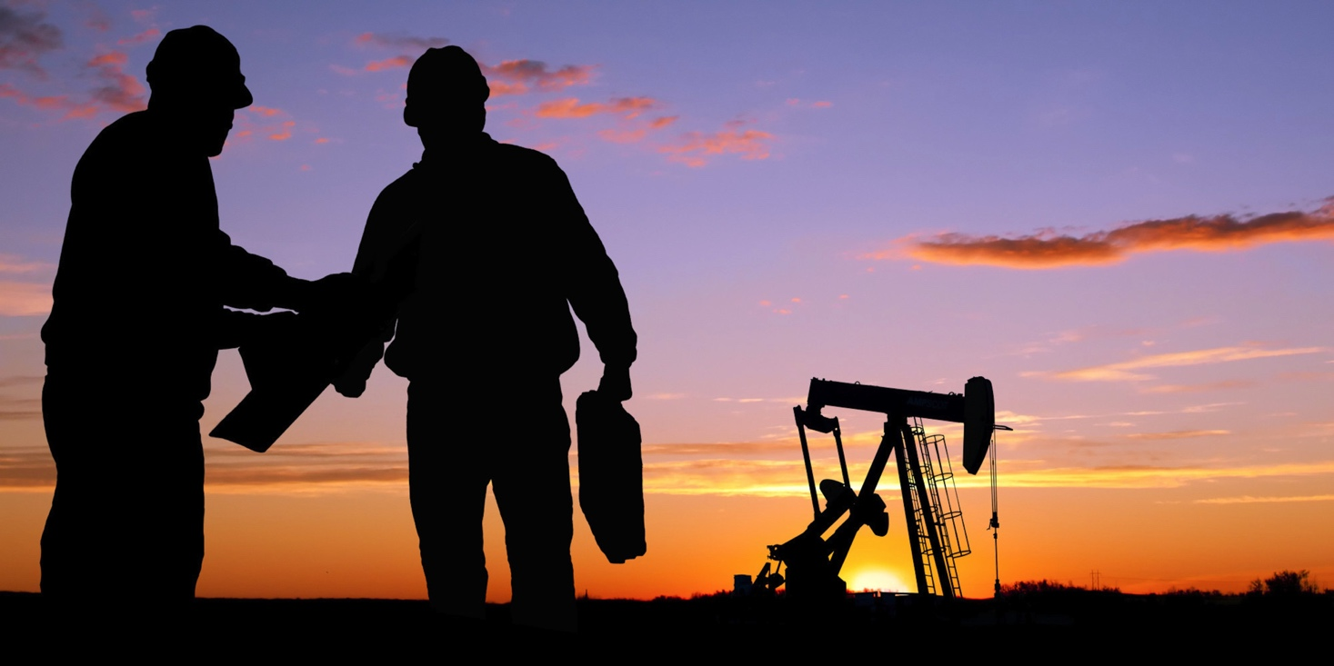
Alberta
Alberta is one of the Prairie Provinces. On the prairies there is a lot of farming.
Alberta is also known for having one of the largest oil deposits in the world.
One of the biggest industries in Alberta is the oil industry.

Slide 6
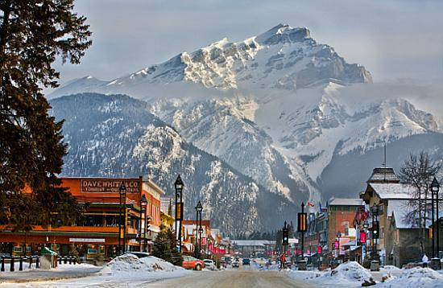
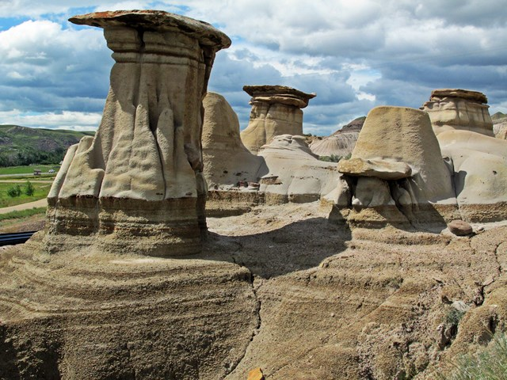
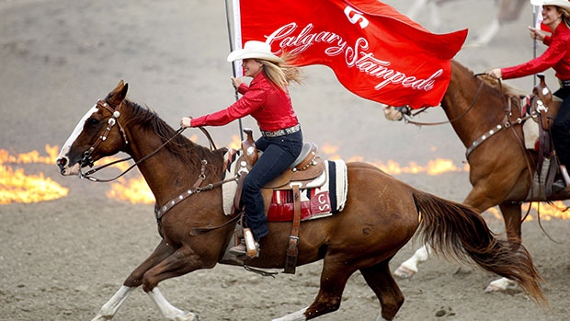
Visit AB
Alberta has many landscapes.
You can see the Rocky Mountains in Banff or Jasper.
You can see the hoodoos in Drumheller.
You can go to Calgary for the Stampede.

Slide 7
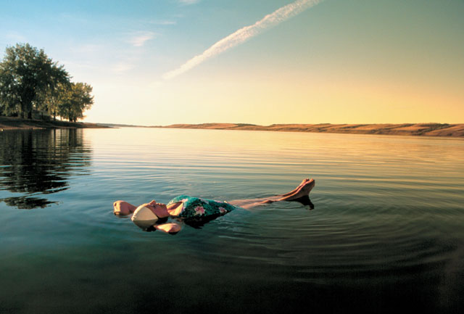
Saskatchewan
Saskatchewan is also a Prairie Province and is known for its farming.
It is very flat, but has many beautiful lakes for fishing and swimming.

Slide 8
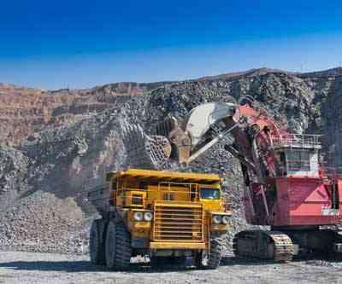
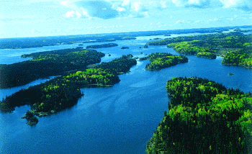
Manitoba
Manitoba is the last Prairie Province.
In Manitoba there is a lot of mining and farming.
It is covered in many forests and lakes.
It is very cold in the winter.

Slide 9
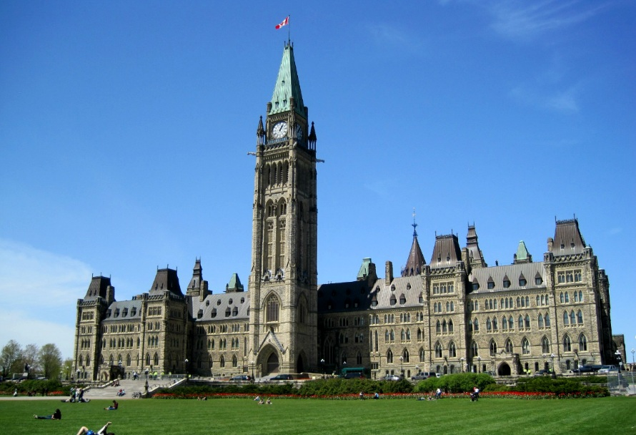


Ontario
Ontario has the most people in Canada. It is also where the Canadian government is (Ottawa).
In Ontario there is a lot of business and manufacturing (factories that make things for people)
Northern Ontario is covered in forests.

Slide 10
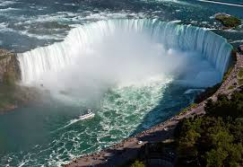
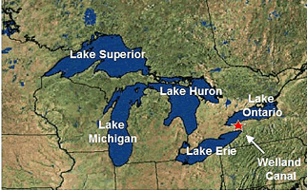

Visit Ontario
Ontario is home to the Niagara Falls.
Ontario is also home to the five Great Lakes.
You can also see an NBA basketball game, an NHL hockey game or an MLB baseball game there! Raptors, Maple Leafs or the Bluejays!

Slide 11
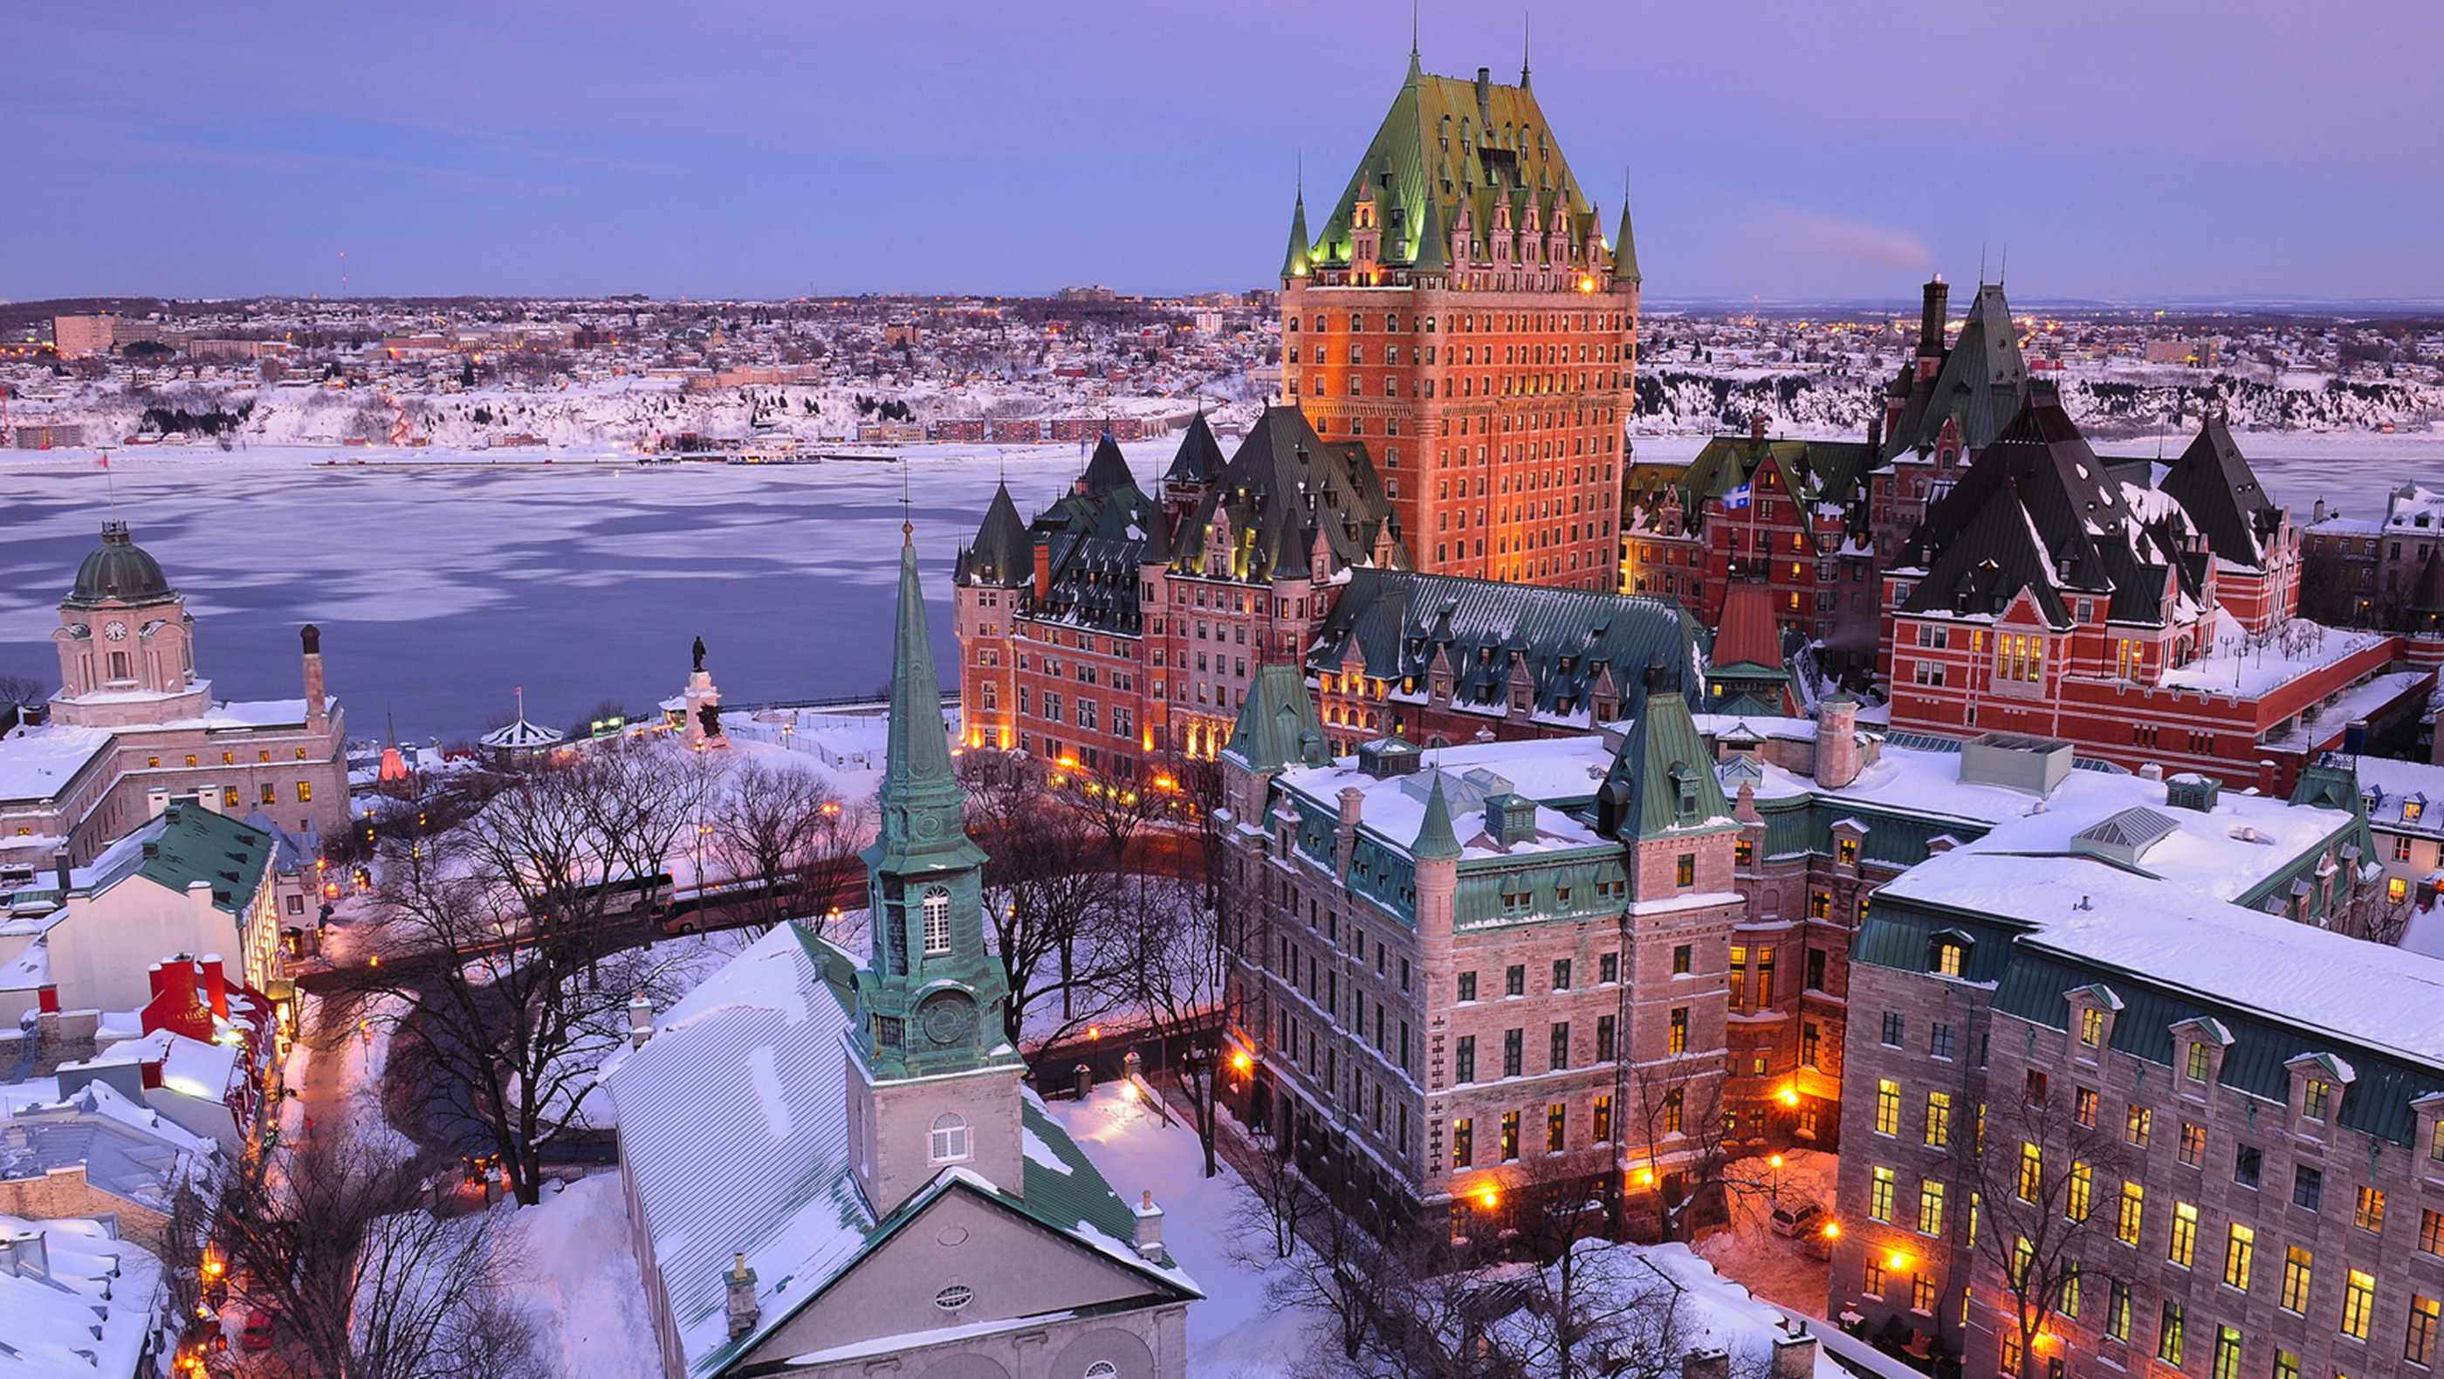
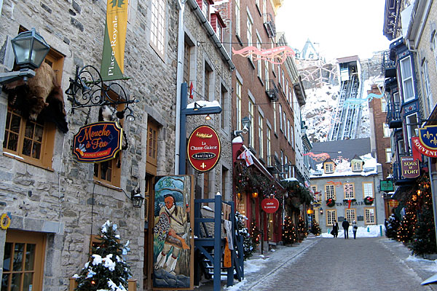
Quebec
Quebec is the only French-speaking province in Canada.
It is known for having a lot of culture and looking similar to Europe in some ways!

Slide 12
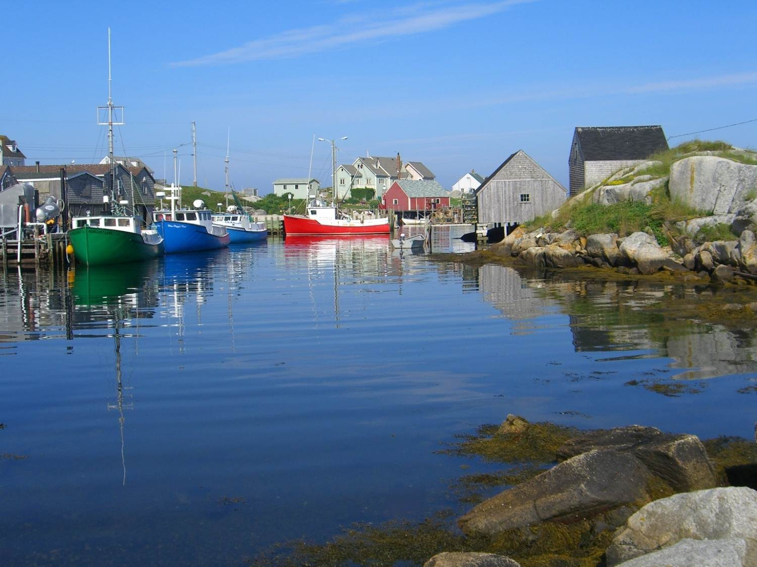
The Maritimes
Prince Edward Island, New Brunswick, and Nova Scotia are the three Maritime provinces.
There is a lot of fishing in the Maritimes and lots of old fishing towns.
It is beautiful on the ocean there, but there is not a lot of work there, so many people have to leave.

Slide 13
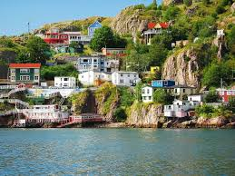
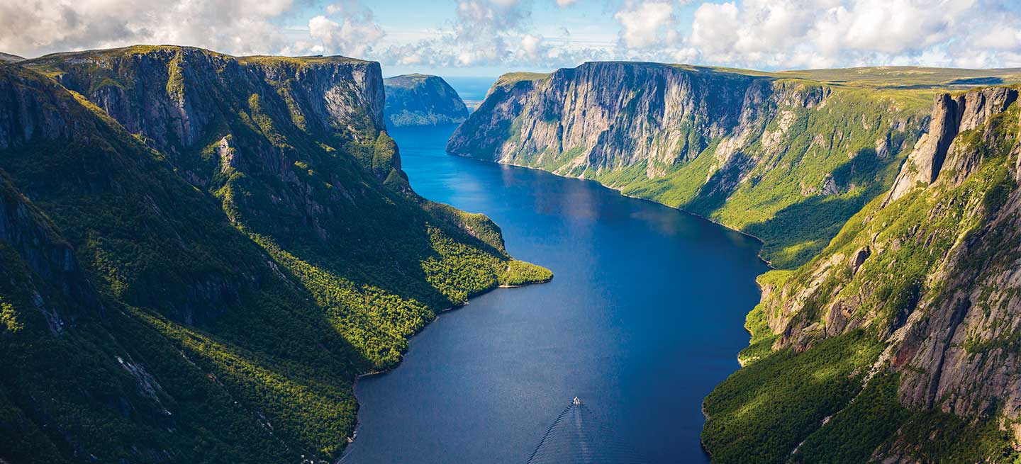
Newfoundland
Newfoundland is known as “the rock” because of its landscape.
There is a lot of fishing there, but there is not a lot of other work. Most of the cities are small.
It is beautiful, but has very cold winters.

Slide 14
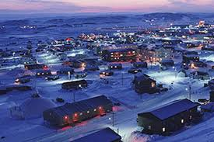
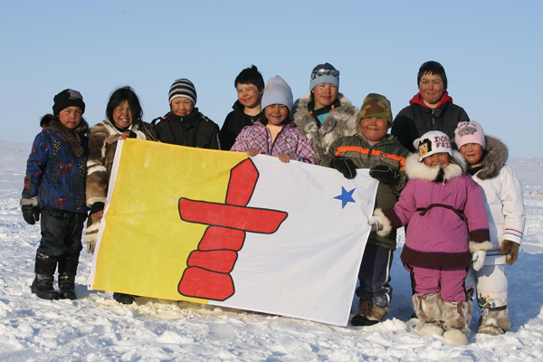
Nunavut
Nunavut is Canada’s newest territory.
It is located very far north and is very cold and dark in the winter.
It is expensive to live in Nunavut and the other territories because it takes a long time to ship fresh food there.
It is home to many Inuit people.

Slide 15
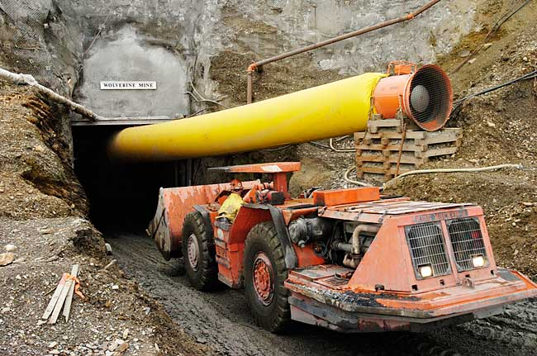
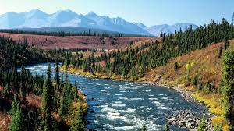
Yukon and the Northwest Territories
The territories are far north, cold, and dark in the winter.
In the Yukon and the Northwest Territories there is a lot of mining.
It is also beautiful with different landscapes like mountains, lakes, and valleys.

Slide 16
Discussion/Writing
If you could visit anywhere in Canada, where would you like to go? Why?
If you could live anywhere in Canada, where would you like to live? Why?
What are the features of your home country? (What does it look like?)

